Slide 1


Who Wants to
Be a Millionaire?
Notes:
Lifeline icons on the question slides are hyperlinks which will take you to the lifeline screen. To return to the game, you may right click on the screen, choose Go, Previously Viewed. This should return you to the question slide. Alternatively, left click as usual to return to the game board, then click on the highest number that has been previously selected (in gold to indicate a followed hyperlink).
To utilize the 50:50 option, the moderator may tell the contestant which two options to disregard or, use Control-P to change the mouse arrow to a pen. Draw a line through two incorrect responses, then use Control-A to change the pen back into an arrow and continue with the game.
Clicking on the action button on the phone handset image of the Phone a Friend lifeline slide will hyperlink to the Ask Jeeves web site where the participant may ask for help.

Slide 2



1,000,000
500,000
250,000
125,000
64,000
32,000
16,000
8,000
4,000
2,000
1,000
500
300
200
100

Slide 3


Click to return to question, Cont-P to switch to the pen, cross out two incorrect answers, then Cont-A to switch back to pointer.

Slide 4

Click to return to the question and poll the class

Slide 5
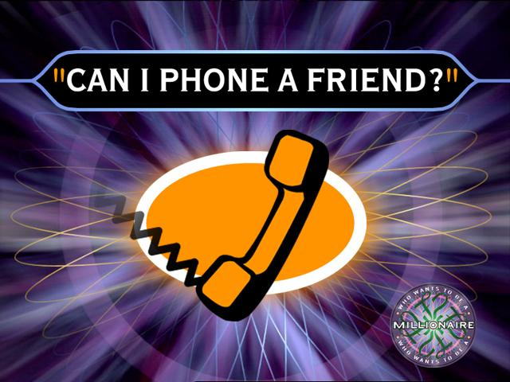
Click on link to Ask Jeeves, or click on this oval to return to question and ask a friend

Slide 6
What is kelseys fouvrite song?
A. fly on the wall
B. walking on sun
shine
C. if we where a
movie
D. pumping up the
party

Slide 7
A. Fly on the wall
Back to Board

Slide 8
Whats Kates to middle names?
A. mary,rose
Ray,charlotte
C. josaphin,charlotte0
D.ella,button

Slide 9
C. josaphin,cholotte
Back to Board

Slide 10
What is Kelseys favourite sport?
A. netball
B. hockey
C.basketball
D. soccer

Slide 11
B. hockey
Back to Board

Slide 12
Whats Kates favrite singer?
A.Miley cyrus
B.zac efron
C.Kattie peery
D.Gordon sparks

Slide 13
A. Miley cyrus
Back to Board

Slide 14
When is Kelseys birthday ?
A.march the 5
B.october the 25
C.december the 27
D. may the 13

Slide 15
D. May the 13
Back to Board

Slide 16
What is kates favorite pet?
A.puppy
B. donkey
C.kitten
D.cat

Slide 17
C. kitten
Back to Board

Slide 18
What is kelseys perents names
A. dietree/mark
B.leanne/shane
C.sona a/simon
D.cole/bill

Slide 19
B.Leanne/shane
Back to Board

Slide 20
How meny brothers dose kate have?
A. 4
B. 3
C. 1
D.2

Slide 21
C. 1
Back to Board

Slide 22
Where is kelsey’s favorite place?
A. ohope
B. auckland
C. taupo
D. ohiwe

Slide 23
D. ohiwe
Back to Board

Slide 24
what is kates favorite song?
A. see you again
B. hot and cold
C. one step at a time
D. I kissed a girl

Slide 25
B. Hot and cold
Back to Board

Slide 26
What is kelsey’s oldst brother’s name?
A. hamish
B. logan
C. joe
D. kerrin

Slide 27
A. Hamish
Back to Board

Slide 28
What is kates parents name’s?
A. josaphine/trever
B. joana/alan
C. Elizabeth/games
D. steven/anna

Slide 29
B. joana/alan
Back to Board

Slide 30
How meny brother’s does kelsey have?
A.2
B. 1
C. 3
D. 4

Slide 31
C. 3
Back to Board

Slide 32
Where is kates favorite place
A. kapereaga
B. ohope
C. taupo
D. cagrona ski felds

Slide 33
D. Cadrona ski felds
Back to Board

Slide 34
How old is kelseys dad
A. 44
B. 41
C. 42
D. 40

Slide 35
A. 44

Slide 36
Sorry, try again!

Slide 37
Thanks for playing!

